Slide 1
The Power of Strategic Sales Coaching
By Ignite Selling Inc.

Slide 2
Why Strategic Sales Coaching?
Improves sales force’s performance which directly boosts the revenue by 10%
Uses go-to-market approach to tune-up and turbo-charge sales engine
Sales coaching by front-line managers improves sales performance
Research shows:
Systematic coaching reduces sales cycle by 18%
18%
Companies with systematic coaching achieve 102% of their sales goals
102%
Sales teams with three hours of coaching per month achieve 107% of their goals
107%

Slide 3
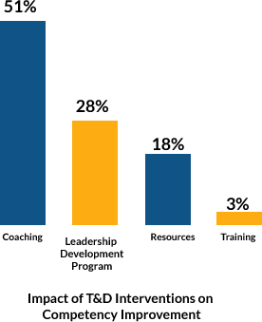
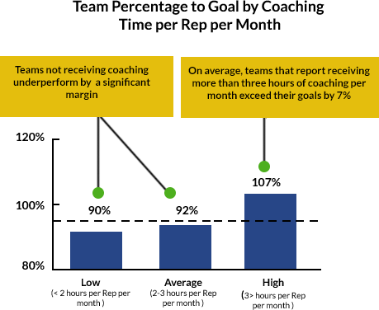
Impact of Coaching

Slide 4
Systematic Sales Coaching
Two ways of systematically coaching your sales force:
Tactical
Strategic
Coach observes rep’s face-to-face selling skills and gives him feedback to aid improvement
Employs methods to help individuals to manage sales pipelines and close deals

Slide 5
The six-step approach to Sales Coaching
Six steps of strategic coaching to turbo-charge your sales engine:
Select your Target
Establish a Preliminary Strategy
Ask the Right Questions
Take Action – Move in for the attack
Check the status
Refine your Strategy

Slide 6
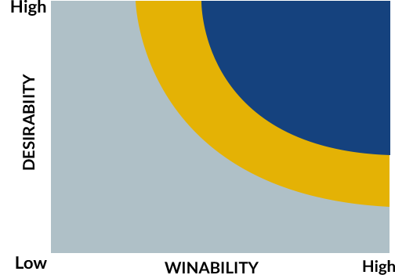
The six-step approach to Sales Coaching
1. Select your Target
Select the correct candidates to coach so you can help them pursue the right accounts
Target client companies which are desirable and winnable
Evaluate the potential target’s revenue and profitability
Check if the sales opportunity aligns with your long-term goals
Verify if your target’s corporate values matches those of yours
Look into target’s position in the market, key stake holders and account decision influencers
High value deals
If time permits

Slide 7
The six-step approach to Sales Coaching
2. Establish a Preliminary Strategy
Strategizing initially is usually ignored, but you have to coach your teams to plan at the right time
Understand your customers fully and draw strategies depending on the circumstances
Consider factors like - decision timeline, budgeting process, decision influencer, criteria used to make the decision and your position against the competition
Gain insights on
Which internal resources could help?
Which influencer should you win over?
What will you emphasize about your solution?
What past-lessons can you apply to this campaign?
Keep the strategies flexible so they can be altered as per changing requirements

Slide 8
The six-step approach to Sales Coaching
3. Ask the Right Questions
Ask the sellers the right questions to break their internal barriers
Through individualized questions, enable the sellers to find ways to achieve success
Form questions that give insights about accounts’ status and the right plan of action
Plan the questions with the intent of coaching rather than putting down the sellers
Ask secondary and tertiary follow-up questions to make the sellers think and analyse

Slide 9
The six-step approach to Sales Coaching
4. Take Action – Move in for the attack
Successful coaching involves not just planning but also putting it into action
Establish well-thought out action plan encompassing:
Time-bound milestones
Clearly defined tasks
Owners of each task
Include timely follow-up activities to check if the plan is progressing as expected

Slide 10
The six-step approach to Sales Coaching
5. Check the status
Frequently check the status of the strategy
See if the strategy has not worked well due to factors out of rep’s control
Determine if the strategy was faulty or the execution was poor
With the insights gathered, learn what worked well and what did not
Utilize the lessons learnt to refine the strategy

Slide 11
The six-step approach to Sales Coaching
6. Refine your Strategy
Refine your strategy by asking ‘what-if ‘ questions
Employ rigorous contingency planning to develop a winning strategy
Make the sellers plan for the unexpected
Identify events that might require you to change your strategy based on,
How would the event occur?
What could trigger the event?
At which point in time might the event surface?
Always keep your strategies flexible to handle evolving circumstances

Slide 12
Outcome of Strategic Sales Coaching
Outcome of Strategic Sales Coaching
Shorter Sales Cycles
Improved team performance
Increased top-line growth
Tuned-up and supercharged sales engine
Sustainable success for the business

Slide 13
About Ignite Selling Inc.
Eight decades of experience in Sales, Sales Coaching and Sales Training
Develops custom sales training solutions
Creators of the Interactive Learning Maps™ for Sales and the Competitive Capstone Simulation™ for Sales
Authors of Premeditated Selling ™ a book chosen by ATD to be “the new way of developing smart sales strategy”
Trained over 10,000 sales people worldwide
Ignites & inspires teams
DOWNLOAD the White Paper to Learn More

Slide 14
Thank you

